Slide 1
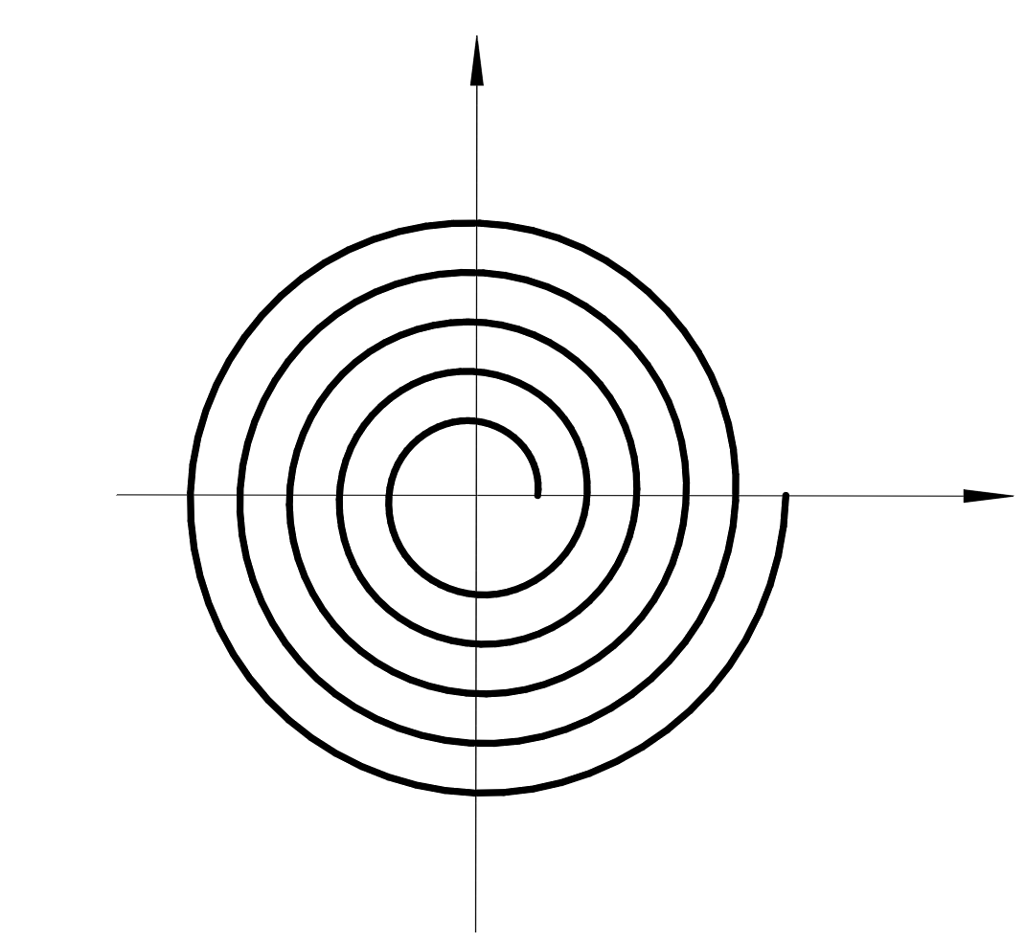


A
air
B
air
C
air
Pump & valve
L
Pressurized body
P
Barometric
Pressure Sensor
air
air
air
eversion
P
$$ω$$
T
Base
Motor
$$R_{1}$$
$$R_{2}$$
$$θ$$
$$δ$$
$$r$$

Slide 2
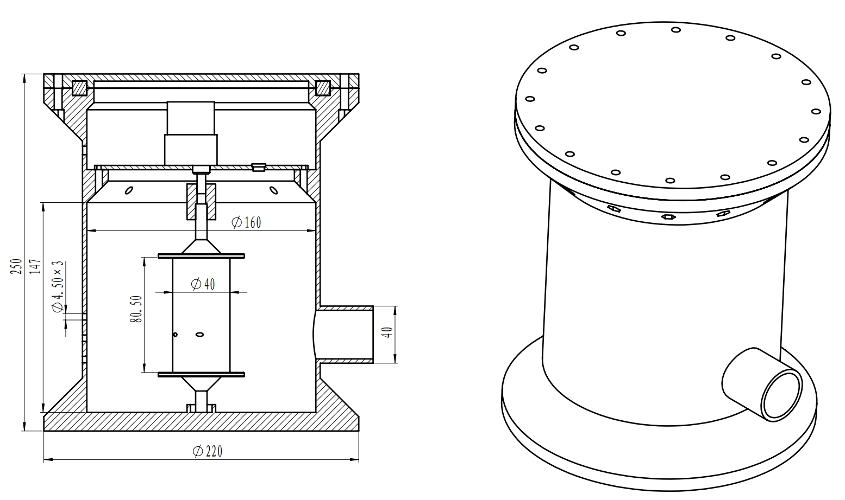
1

Slide 3
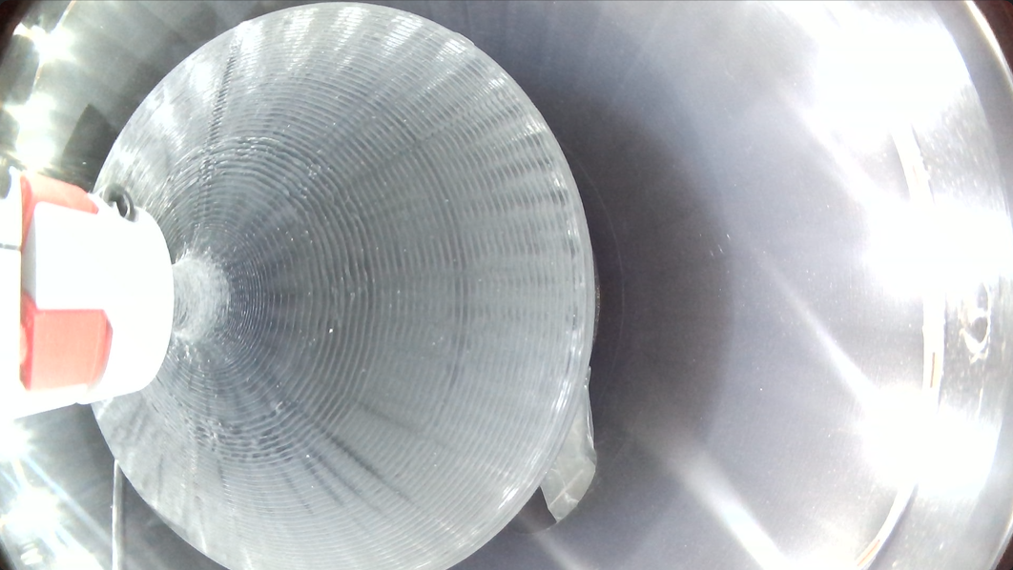
2
4
1
3

Slide 4
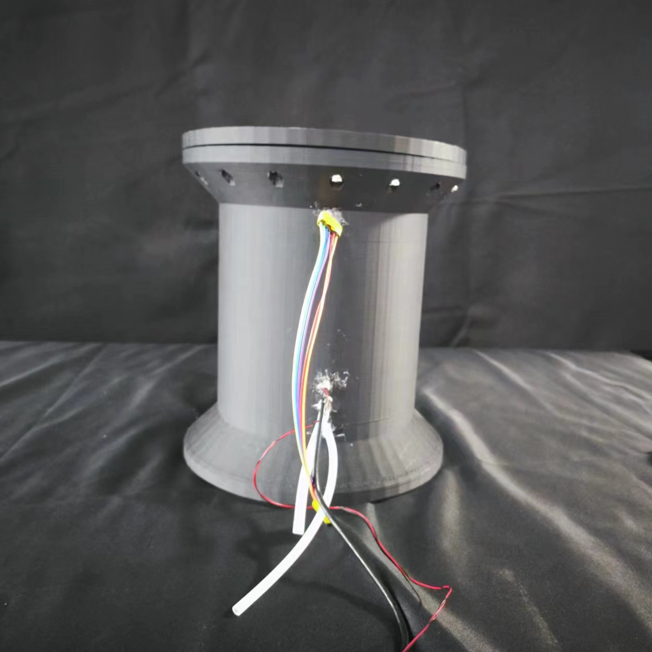
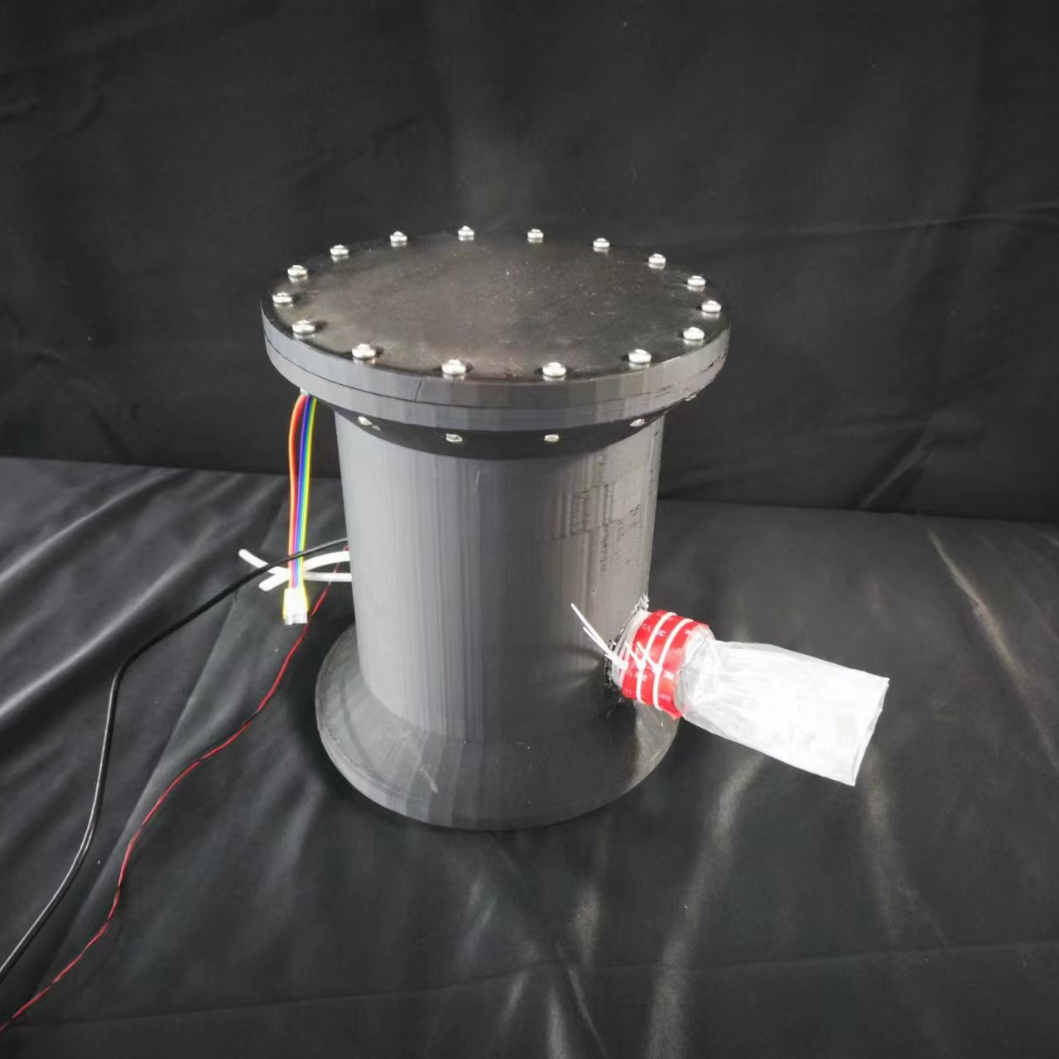
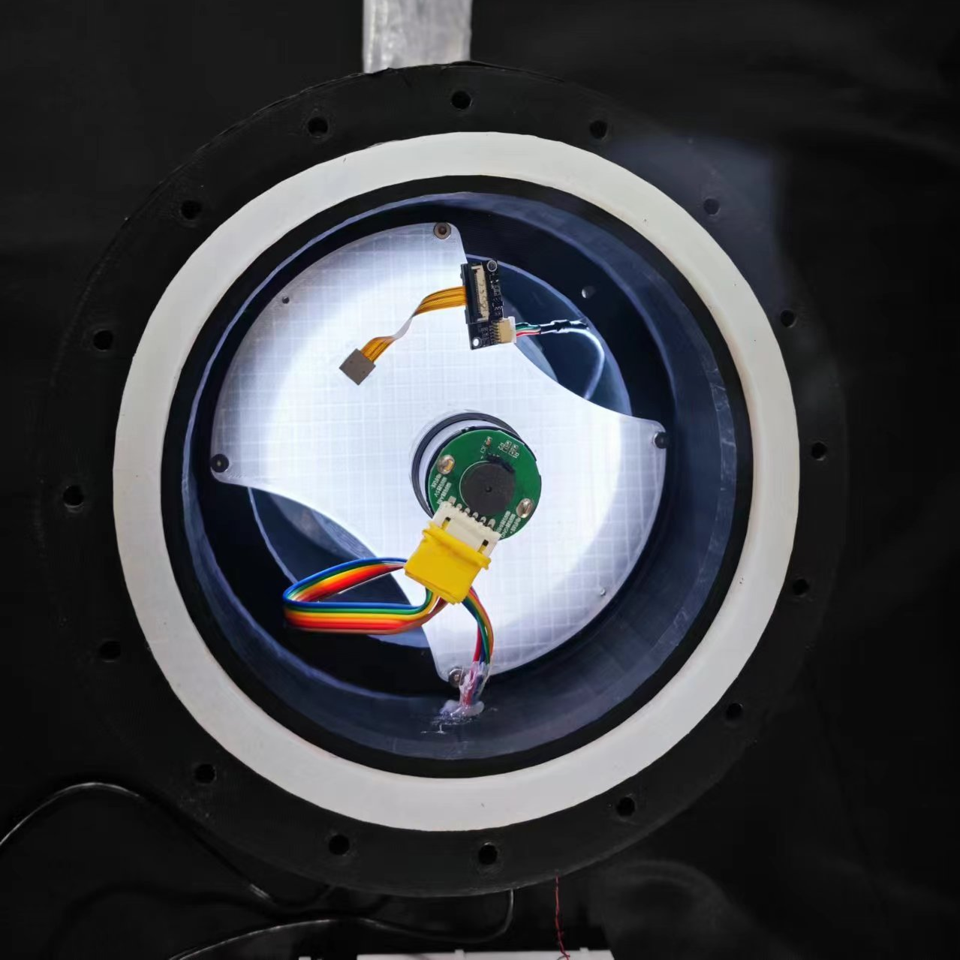
A
B
C
3
1
2

Slide 5

Operating End
PC
Camera
Sending Command remotely
Real-time Image
Serial / USB
TB6612(1)
(Actuater)
PWM1
PWM1
Pump
Bluetooth
Bluetooth
PWM2
TB6612(2)
(Actuater)
PWM2
DC Motor
Serial
Encoder
STM32C8T6
Encoder Signal
Encoder Signal
ADC
Pressure Sensor
Analog Signal

Slide 6
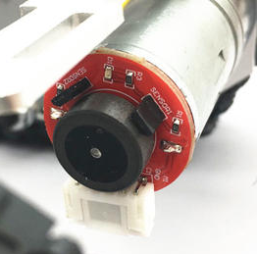
A
B
C
Edge | The other state
A↑ | B LOW
A↓ | B HIGH
B↑ | A HIGH
B↓ | A LOW
A
Forward
B
Edge | The other state
A↑ | B HIGH
A↓ | B LOW
B↑ | A LOW
B↓ | A HIGH
A
Backward
B

Slide 7
Controller
Disturbance
Kp
+
Control Signal
DC Motor
Setpoint
Ki
Actual Position
-
Kd
Encoder

Slide 8
Set Position
Start
Set Perssure
Actual Pos.
= Set Pos. ?
Yes
Actual Per.
>= Set Per. ?
Yes
No
No
Control DC motor(PWM)
Start the pump
No
Set another postion ?
Yes
Enter the new position

